Slide 1
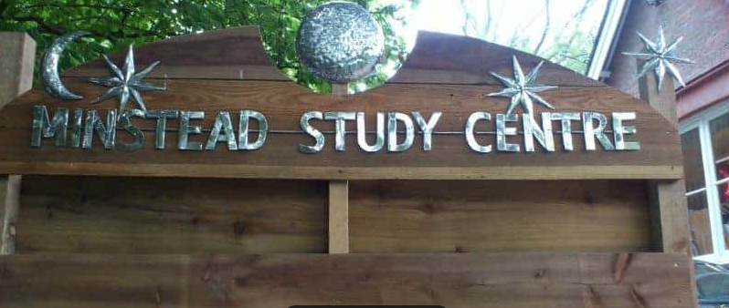
Welcome to

Slide 2
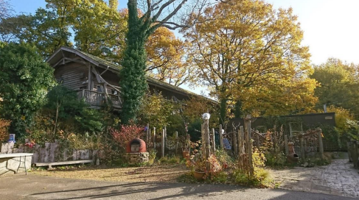
M
instead
Study Centre
Minstead Study Centre is a Hampshire County Council run environmental study Centre
Set in the heart of the New Forest National Park
The Centre has been in existence for more than 50 years
Help children build connections to the natural world
Groups get sole residential use of the centre – when they are staying here they will be the only group staying here
With focus around our Key Words:

Slide 3
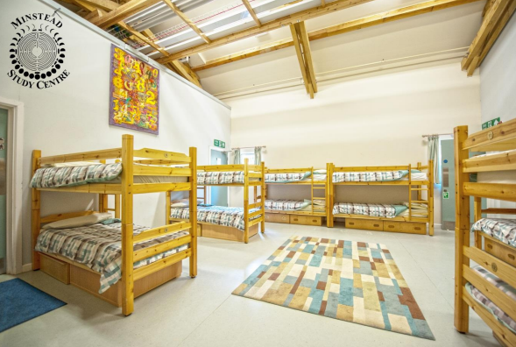
Dorms
There are 2 large bunk rooms contained in the cosy accommodation block
Modern and cosy with underfloor heating!
Each bedroom has en-suite shower and toilet facilities and a boot room.
Teachers sleep in rooms nearby to the children
The building is locked at night by school staff
Centre staff are on call overnight, and can be contacted by visiting leaders in case of emergency.

Slide 4
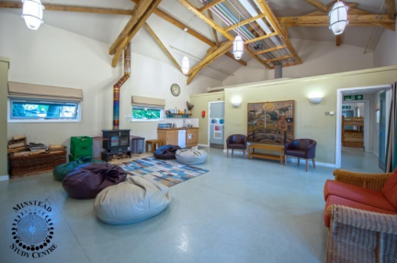
Social room
In addition, the accommodation block has a central social room, perfect for hot chocolate in the evenings before bedtime!
Children can bring their own non-electrical games to play during their downtime eg. card games.

Slide 5
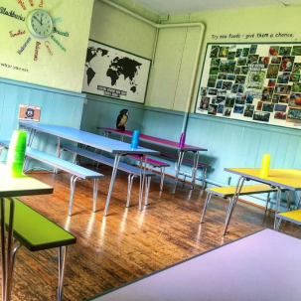
Food
The kitchen and dining room are situated in the Victorian school building, next door to the accommodation block.
Continental breakfast – choice of cereals and croissants one day!
Children make own packed lunches. Children make their own lunches so can choose what goes in them.
Warm home cooked meal in the evening, making use as much of possible of produce grown on site, or bought from local suppliers.
Snacks are also provided throughout the day – no child will go hungry!
The catering team are used to providing food for children with special diets.

Slide 6
Dinner
Meal options for dinner are as follows:
Pasta bolognaise / veggie bolognaise
Margherita Pizza
Served with potato wedges / garlic bread / salad

Slide 7
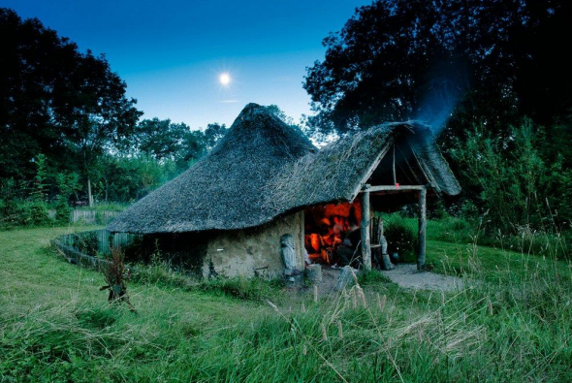
Outside
7 acres of land - where many of the activities take place during the day.
The grounds have been designed with primary schools in mind and there are many areas which provide excellent opportunities for education activities to take place – woodlands, vegetable gardens, meadows a large, fenced pond and a beautiful thatched roundhouse
Lots of space to play, explore and let off steam.
A small flock of friendly sheep
With the location in the heart of the National Park, obviously we will be enjoying the surrounding areas

Slide 8
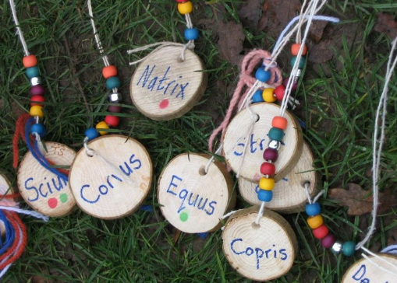
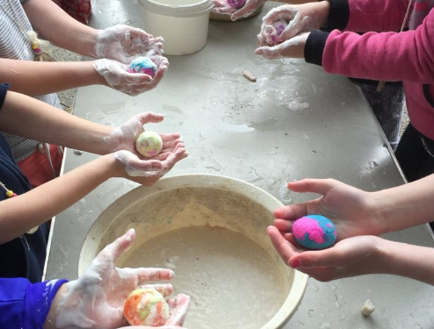
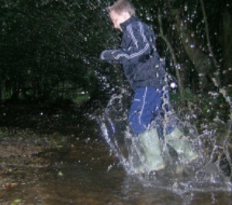
Activities
Groups who stay with Minstead find that no matter what activities they select, their pupils show increased confidence and independence
Wide variety of activities help to created more motivated learners!
Activities include curricular subjects, such, as science, geography, history and art
The activities are led by the centre’s experienced education team – all of whom have extensive experience working in schools and Centres

Slide 9
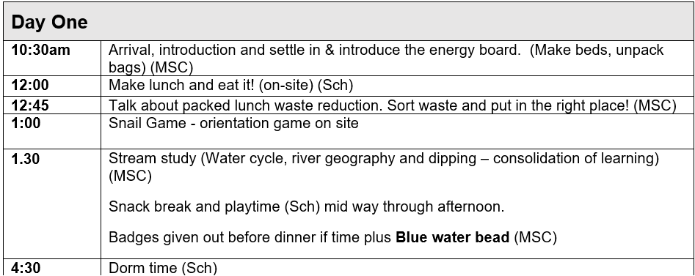
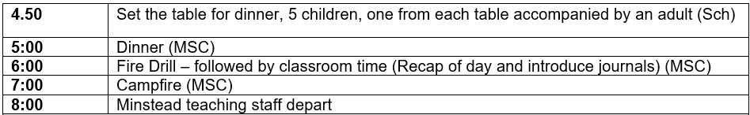
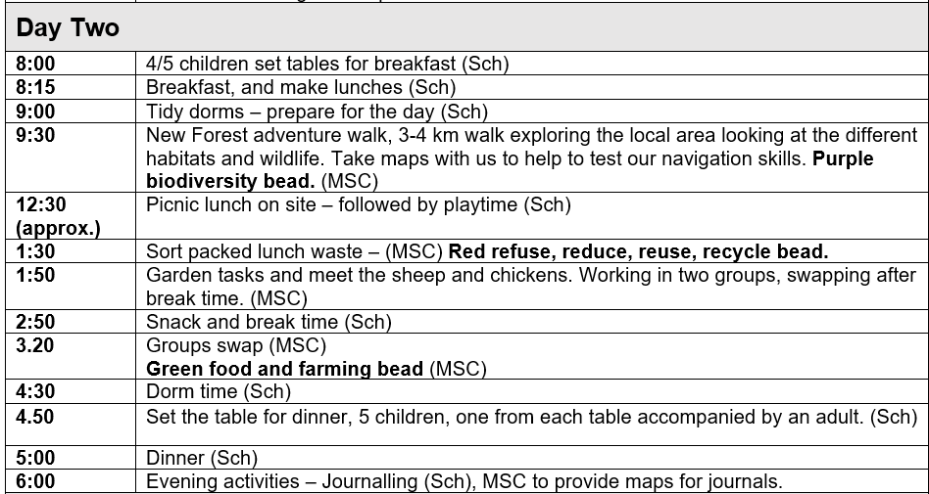
Timetable

Slide 10
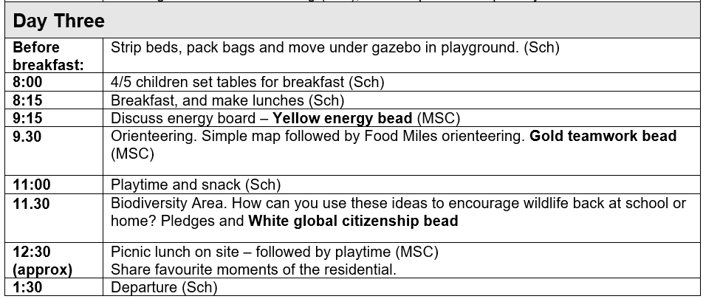

Slide 11
Health and Safety
Security - At night, visiting teachers are given the keys to the buildings and shown the locking up procedure – and once locked no visitors are able to enter.
There are interior twist lock to aid emergency exit.
The grounds of the Centre are surrounded by fences and hedges, giving children a safe and secure place to part in our activities.
Fire - The Centre maintains a comprehensive fire risk assessment to ensure that we maintain the highest standards of fire safety.
All residential school visitors complete a fire drill on the first day of their visit.
All areas of the accommodation block are covered by a sprinkler system and a modern and extremely sensitive fire alarm system.

Slide 12
Health and Safety
Risk Assessment - During their stay children will complete a wide range of activities, all of which have been comprehensively assessed
All activities are planned by experienced members of staff.
Safeguarding - All staff have undergone an enhanced level DBS check before being cleared to work.
All visiting adults on site are asked to wear an identification badge and to sign in and out at reception.
First Aid - All residential children’s groups bring an adult who is able to take on the role of ‘first-aider’.
Minstead Study Centre also have trained first-aiders on the staff

Slide 13
What do I need to pack for my child?
Kit List – Please name all items
The accommodation is in centrally heated dormitories, equipped with washrooms and showers. There are indoor classroom facilities, but most of the time will be spent outdoors whatever the weather! Suitable clothing and footwear are essential.
Wellingtons (with a separate bag to put them in, and either thick socks or lots of socks!))
An additional pair of outdoor shoes (trainers etc)
Slippers, or alternative indoor shoes.
Long trousers for activities
Tops
Waterproofs - coat (essential) and trousers (if possible)
Fleece or jacket
Gloves, hat, scarf, extra sweaters (in colder months)
Insect repellent, sun screen and sun hats (in warmer months).
Nightwear
Extra socks and underwear
Toiletries (in a washbag)
Towel
Large plastic bag for dirty clothing and spare plastic bags for shoes
Small game for free time (e.g. Top trumps)
Water bottle
Book
Binoculars, disposable cameras and compasses can be brought along, but children will need to care for their own property. All cameras must stay in the social room.

Slide 14
“There’s no such thing as bad weather – only a bad choice of clothing”

Slide 15
Please don’t bring
Aerosol sprays
Bedding
Mobile phones, smart watches, electronic games etc
Food and drink.

Slide 16
Things to help my child prepare for Minstead….
Pack your child’s bag with them: make a list of each item in their bag as they will be responsible for re-packing it at the end of the week!
Have a quiet weekend before and after Minstead – it is a very tiring experience for children, they will need early nights!
Make sure your child is able to care for themselves independently: showering, brushing teeth, brushing hair etc We will remind them as necessary!
As we are only at the Centre for 2 nights we would recommend that children wash their hair the night before they come, so they don’t need to wash it whilst we are there!

Slide 17
Groups and Adults
Group 1 – Monday 20th April – Wednesday 22nd April
Group 2 – Wednesday 22nd April – Friday 24th April
Miss Ashbolt, Miss Palmer, Mr Wakeford and Mrs Eccleston will be there all week.
Mrs Smith will be there Wednesday – Friday.
Mrs Pothecary will visit us on Wednesday.

Slide 18
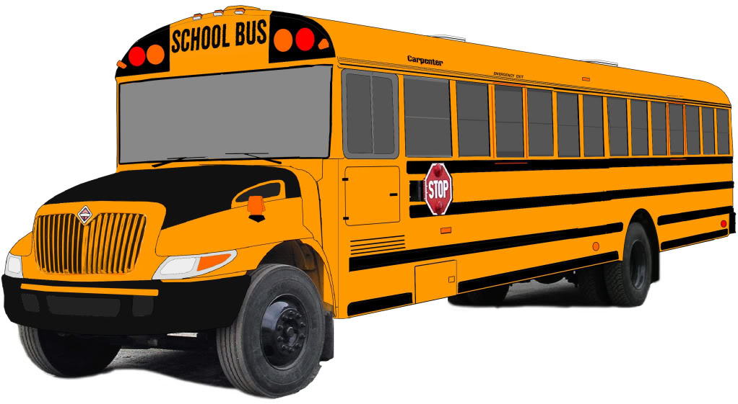
Meet in the Hall
Come into school at the normal time
Bring children and cases to the small hall
Sign in with class teacher
Leave for Minstead at around 9.45am
Please give in medicine (clearly labelled) to the office 1 week before we depart.

Slide 19
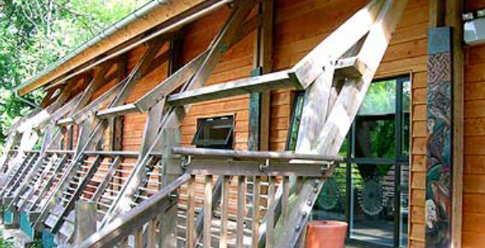
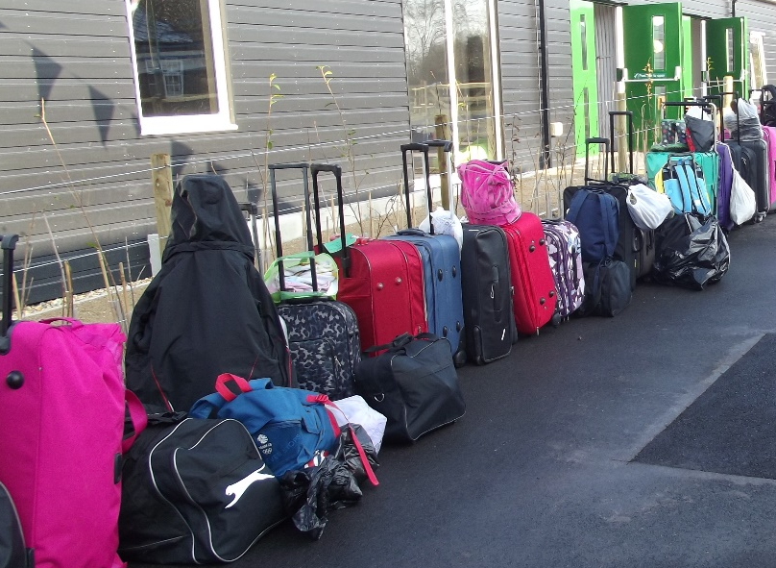
Coach will arrive around 10.30 am at Minstead
Departure – we will be leaving
Minstead at 1.30pm, so
will arrive back at school at
around 2pm

Slide 20
What we need from you:
Medical and Dietary requirement form
Hoodie/T shirt form (if required)
Facebook permission – Please email adminoffice@crescent.hants.sch.uk if you are not happy for your child to be on our school Facebook account.
Please don’t send food in their bag!
Please email if you have any questions that we have not answered!
Please return ALL FORMS to the office by Friday 20th March.

